Slide 1







KitchenSync
Team Neon Nomads

Slide 2

Agenda
01
02
03
04
Introduction
Improvements from last feedback
Project Description
Team Members Roles and Responsibilities
05
06
Personas
Teamworking Agreement
07
08
MVP
Technologies and Languages
09
10
Diagrams
Algorithms
11
12
Sprint 2 Recap
User Stories

Slide 3
Agenda
13
14
15
16
Acceptance Criteria
Sprint 3 Backlog
Test Cases
Stories Completed
17
18
Team Velocity and Committed Ratio
Stories Not Completed
19
Burndown Chart
20
Retrospective
21
WebApp Screenshots
22
GitHub Link
23
Live Application

Slide 4

Improvements from Last Feed Back
1
Architecture diagram was changed
Pain points and challenges were added
Algorithms were added
Team Velocity is added
Stories completed and not completed were added

Slide 5





Introduction
02
KitchenSync is a comprehensive platform designed to make meal planning and pantry management a simple part of your daily routine. It's not just another tool for organizing the kitchen. Whether you're a working professional with a hectic schedule or a parent balancing the obligations of family life, KitchenSync is here to make your kitchen experience more efficient.

Slide 6
Project Description
03
KitchenSync streamlines your pantry management and meal planning seamlessly.
For those with active lifestyles and families
who find it challenging to keep up with their pantry inventory and curb food disposal,
the KitchenSync
is a sophisticated kitchen assistance platform,
that enhances the management of your pantry and offers recipe options that fit your available ingredients, organizes meal plans, and reminds you of the shelf life of your food items,
unlike conventional inventory systems and static shopping list apps
our application intelligently adapts to your dietary preferences and schedule, guaranteeing the optimal use of your groceries and simplifying the meal preparation process.

Slide 7





Team Members & Roles
04
Hemanvitha
Mylapalli
Shashank Akavaram
Neha Srinivasaiah
Frontend Developer
Team Leader
Frontend Developer
Scrum Master
Yuga Kapil Krishna
Maytheramatla
Devops Engineer
Backend Developer

Slide 8




Team Members & Roles
Bala Sahithi
Kamana
Sasank
Nannapaneni
Aditya Gadhave
Sujitha Chethireddy
Software Developer
Backend Developer
Software Developer
Software Test Engineer

Slide 9

Teamwork Aggrement
05
The goal of our Teamwork Agreement is to establish expectations for behavior in an attempt to foster collaboration and productivity.
The specific roles and responsibilities of each member may vary as the project progresses.
One meeting per week is scheduled for Saturdays, and daily meetings are held for Scrum. Important decisions will be made collectively, documented, and shared with all participants.
Agendas are distributed beforehand by WhatsApp or email.

Slide 10



Personas
06
A persona is an imaginary client that personifies the traits of a subset of your customers. For the purpose of creating your product or service, the Persona provides useful information about those clients' demographics. Their objectives, driving forces, and constraints.

Slide 11



Persona 1
Cael 21 years old, freshman
Background: A freshman at Pace University from a low-income family living in a dormitory. He’s on a tight budget and needs to make his grocery shopping as efficient as possible.
Personality: Cheerful, disciplined, hardworking, initiative
Pain points: Limited budget, inexperience in meal planning, difficulty in finding recipes.
Challenges:
Unnecessary purchase, eating healthy, managing a small food storage.

Slide 12



Persona 2
Ella 32 years old, Advocate
Background: Ella is an advocate who is leading a busy lifestyle. She is health conscious and enjoys cooking nutritious meals at home.
Personality: Altruistic, organized, passionate, perseverance
Pain points: Managing her schedule, locating recipes that meet specific dietary preferences, keeping track of expiration dates
Challenges:
Efficiently organizing pantry items, meal planning

Slide 13



Persona 3
Michelle 44 years old, Busy Mom
Background: Michelle is a working mom of four. She juggles between a demanding job and household responsibilities.
Personality: Empathetic, forgiving, nurturing, patience
Pain points: Balancing a demanding job and household responsibilities, over-purchasing, and desire for a system to assist with a recipe suggestion
Challenges:
Coordinating meals to fit into a busy schedule, managing a large and diverse food inventory, and reducing food wastage.

Slide 14
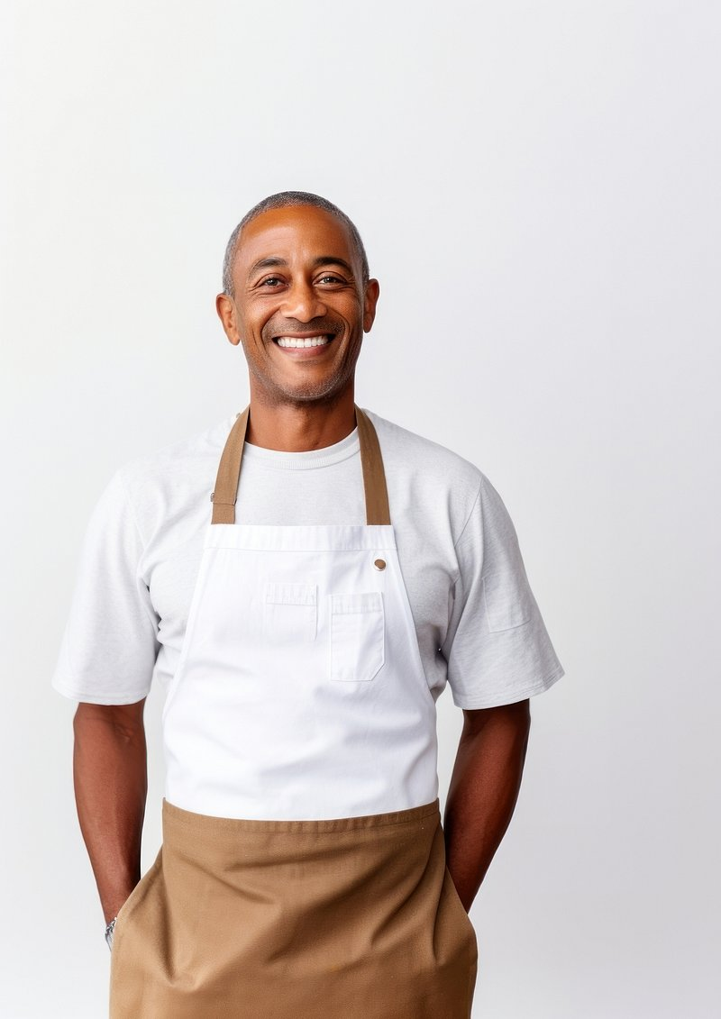


Persona 4
Diego 49 years old, Restaurant Manager
Background: Diego manages a small restaurant specializing in local cuisine. He’s constantly balancing various tasks and often overlooks inventory management, leading to occasional food wastage.
Personality: Creative, Community-Minded, Entrepreneurial, Passionate
Pain points: overlooking inventory management due to multitasking, the need for a system to suggest recipes and expiration alerts.
Challenges:
Streamlining inventory management and reducing food wastage.

Slide 15
MVP(Minimal Viable Product)
07
The MVP of KitchenSync aims to streamline pantry management for busy individuals and families, organizing ingredients, and sending food expiry reminders. It aims to reduce food waste and make cooking easier by adapting to users' dietary needs and schedules.
Benefits: KitchenSync aims to reduce food waste and costs, increase meal prep efficiency, improve nutritional goal adherence, and decrease expired food consumption through smart pantry tracking, tailored recipes, meal planning, and freshness reminders.

Slide 16











Technologies and Languages
08
Python
HTML
CSS
JavaScript
Flask
SQLite
VisualStudio Code
GitHub
Jira Board
Anaconda

Slide 17



Algorithms and Libraries
09
Tensorflow
Scikit Learn
Keras

Slide 18
Algorithms and Libraries
09
MobileNet Models are deep learning models optimized for mobile and edge devices. In our project, we used MobileNet for image recognition tasks, such as identifying identifying recipe and nutritional value of the food item from the uploaded image.
K-Nearest Neighbors is a simple, versatile machine-learning algorithm used for classification and regression. We used KNN to suggest recipes by finding the closest match to the uploaded image.
VGG16 is a convolutional neural network model known for its effectiveness in image recognition. VGG16 was utilized for analyzing images of food to help with recipe generation.

Slide 19
Algorithms and Libraries
09
Random Forest is an ensemble learning method used for classification and regression. This algorithm is deployed to predict the nutritional values of uploaded items of food.
Web Scraping was used to gather recipes from the internet to find appropriate recipes and their nutritional values.

Slide 20
Diagrams
10
Architecture Diagram
Context Diagram
ER Diagram
Sequence Diagram
State Diagram
Class Diagram

Slide 21
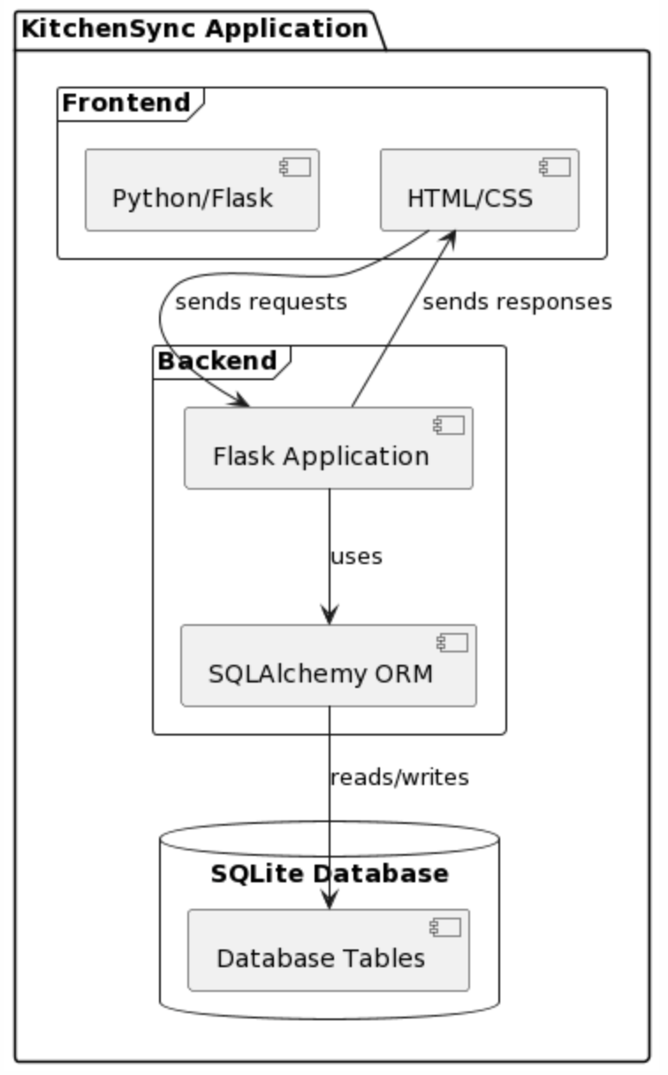
Architecture Diagram

Slide 22
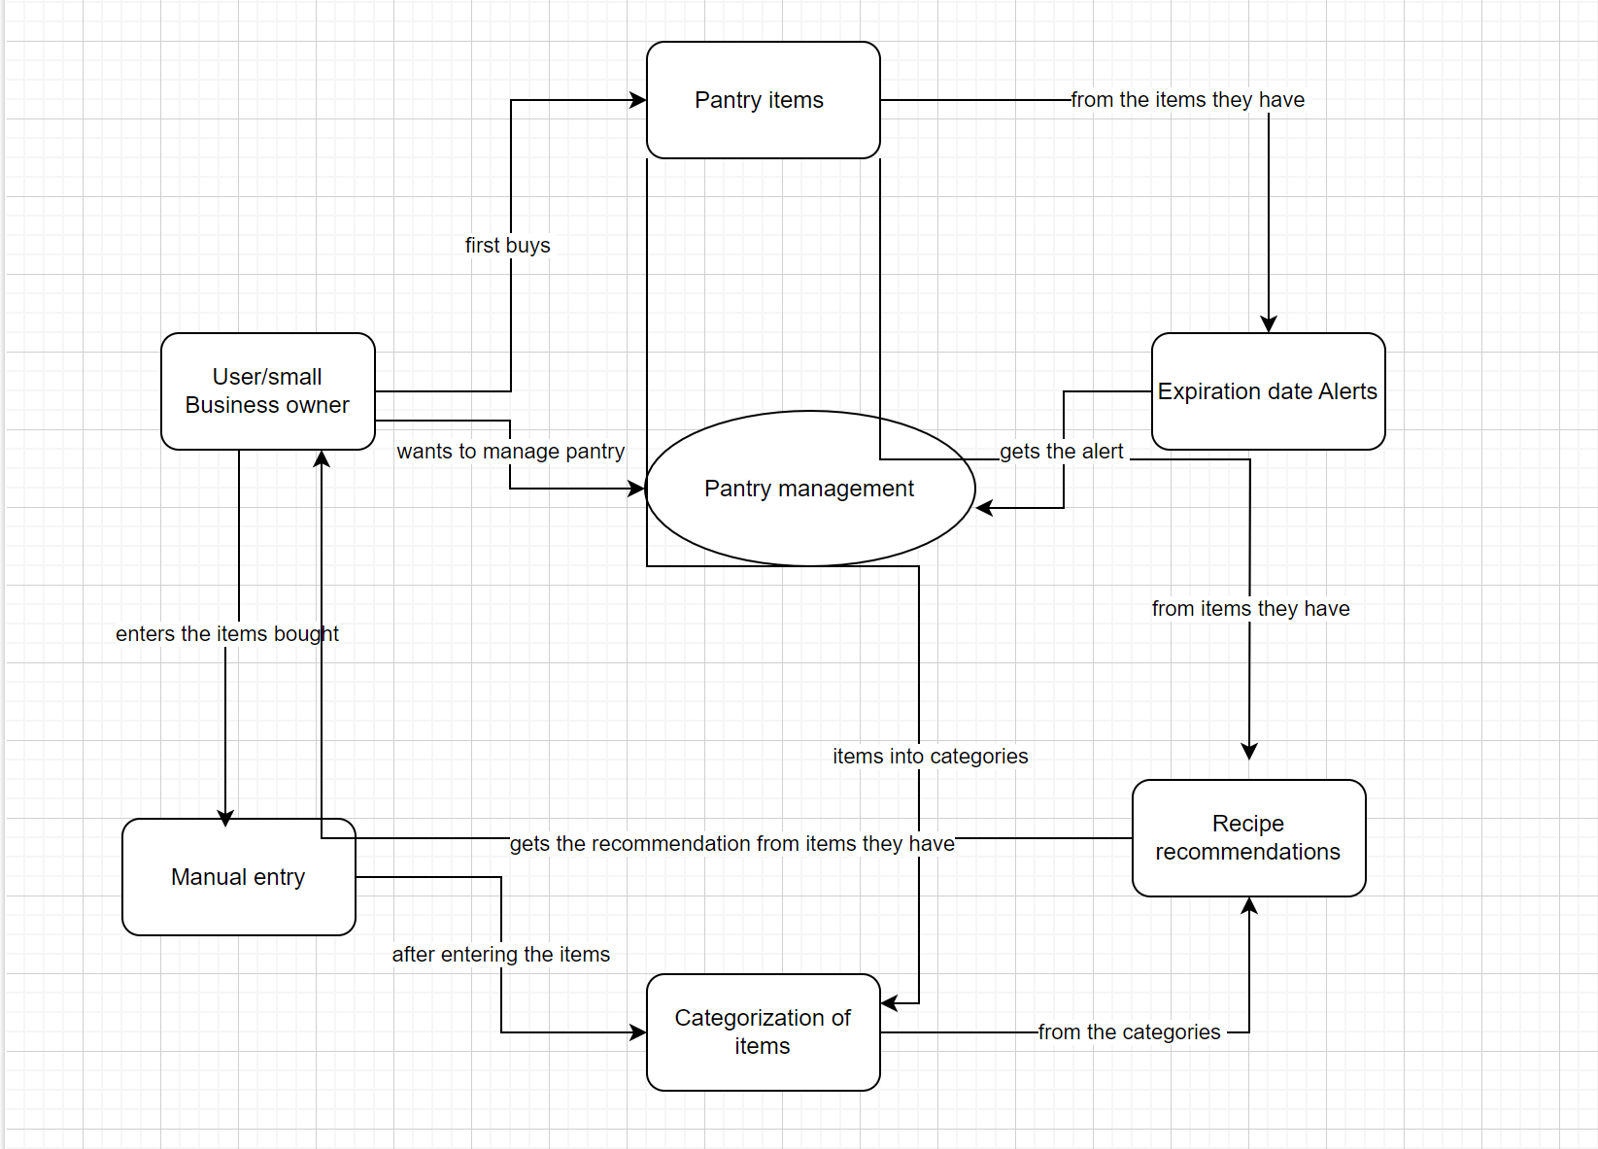
Context Diagram

Slide 23
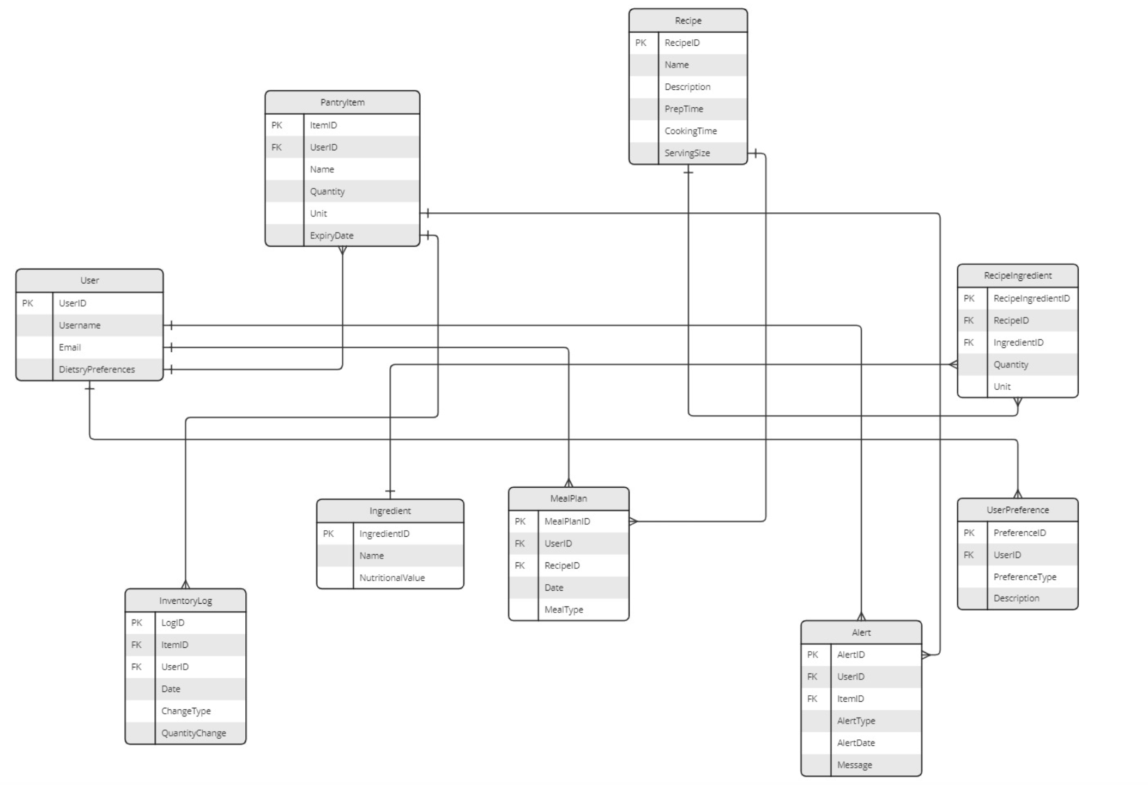
ER Diagram

Slide 24
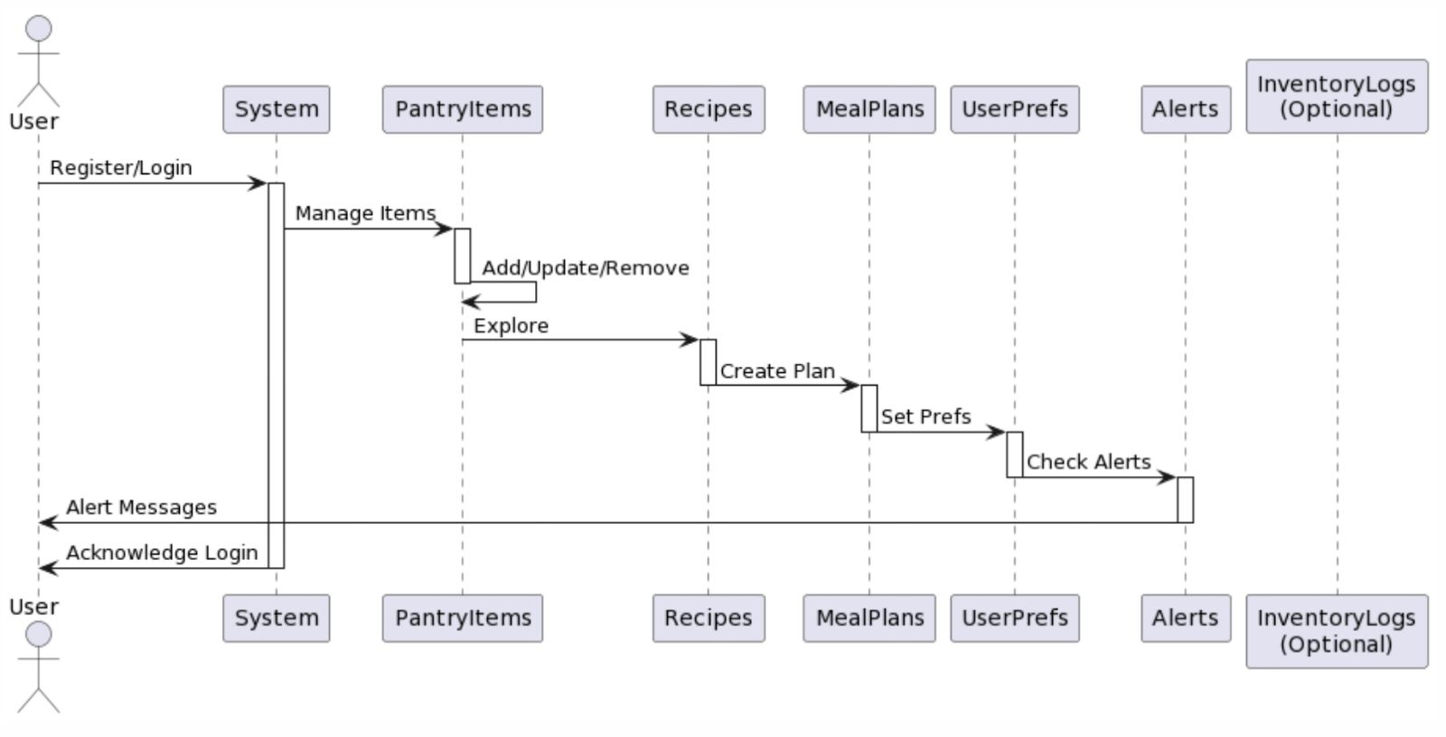
Sequence Diagram

Slide 25
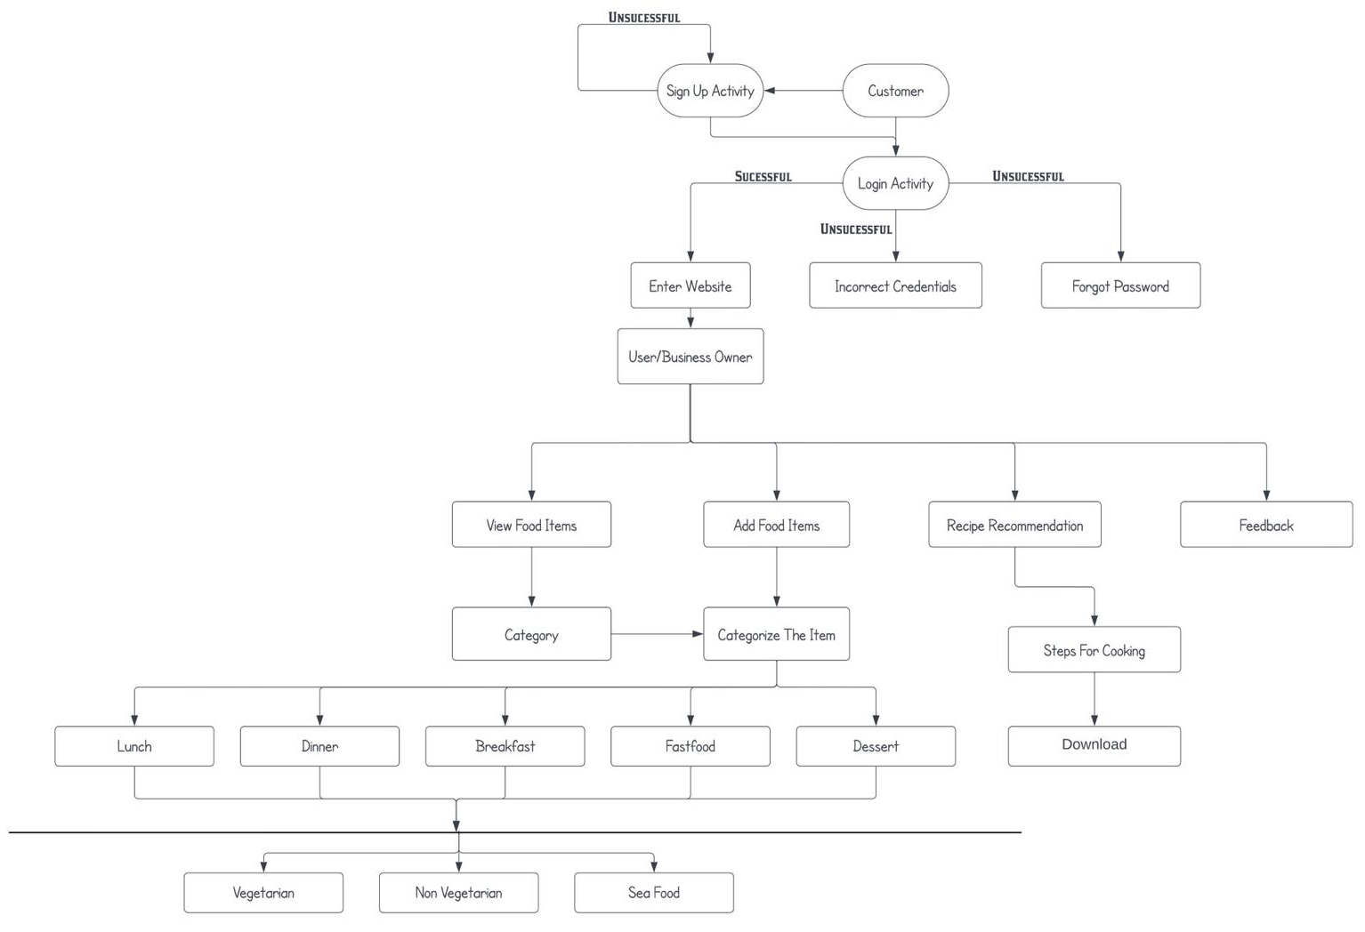
State Diagram

Slide 26
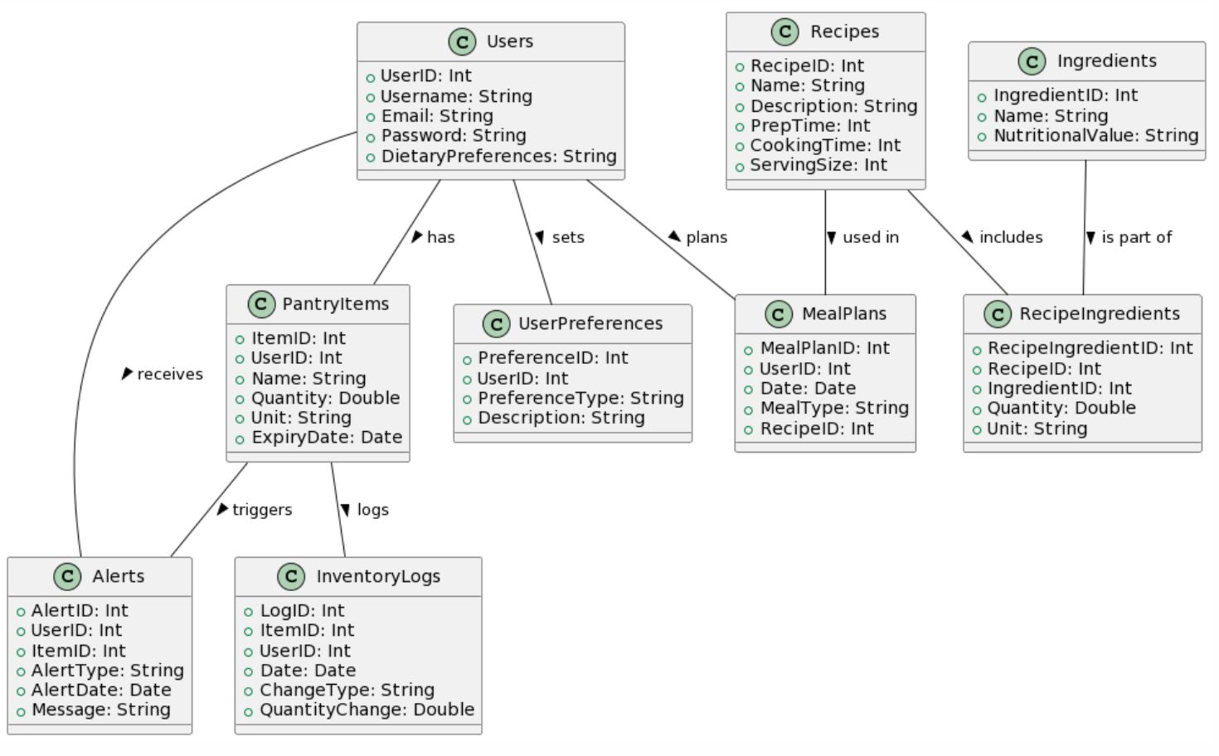
Class Diagram

Slide 27
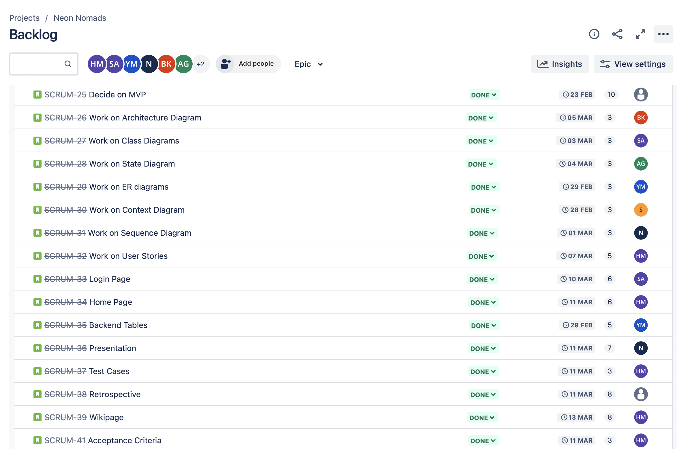
Sprint 2 Recap
11
Sprint 2 (feb 15-mar 13)

Slide 28
Sprint 2 Recap
11
Sprint 2 (Feb 15-Mar 13)
We’ve worked on User Stories, Acceptance Criteria, Test cases, and UML Diagrams, and we also started working on building our MVP.
We finished the pages of inventory management which allows the user to add or update the items in their inventory.

Slide 29
User Stories
12
Estimation | User Id | As a | I want to | So that | Feature | Sprint | Status
13 | 1 | Student on a budget | track my food expense | I can manage my budget more effectively | Expense Tracking | Sprint 4 | to do
8 | 2 | Busy Parent | easily upload my grocery receipts | I can automatically update my pantry inventory | Receipt Upload | Sprint 4 | to do
5 | 3 | Health-conscious Individual | check the nutritional value | I can maintain my dietry regimen without hassle | Nutritional Value | Sprint 3 | done
8 | 4 | Environmentally Aware User | be alterted about food nearing expiration | I can reduce food waste | Expiry Notifications | Sprint 4 | to do
2 | 5 | Gourmet Cook | access a wide variety of recipes | I can explore new dishes and cuisines | Recipe Recognizer | Sprint 3 | done
8 | 6 | Parent with multiple kids | plan meals for the whole week | I can organize my shopping and cooking schedule better | Recipe Recognizer | Sprint 3 | done
8 | 7 | Novice Cook | have step-by-step cooking guides | I can learn to cook with more confidence | Recipe Recognizer | Sprint 3 | done
8 | 8 | Recipe Entusiast | upload my own recipes and share them | I can contribute to the community and save my favorites | Recipe Upload | Sprint 4 | to do

Slide 30
User Stories
12
Estimation | User Id | As a | I want to | So that | Feature | Sprint | Status
1 | 9 | College Student | find recipes based on the ingredients I have | I can avoid buying extra groceries | Recipe Recognizer | Sprint 3 | done
5 | 10 | Bakery Owner | manage my inventory of baking ingredients | I can prevent shortages and reduce excess waste | Inventory Management | Sprint 2 | done
8 | 11 | Restaurant Manager | track the freshness of my perishable stock | I can ensure the quality of the dishes served | Freshness Tracking | Sprint 4 | to do
3 | 12 | Pastry Chef | receive alerts when specific ingredients are low | I can reorder supplies in time for baking | Expiry Notifications | Sprint 4 | to do
2 | 13 | Restaurant Chef | access a wide variety of recipes | I can quickly offer my dishes | Recipe Recognizer | Sprint 3 | done
5 | 14 | Head Chef | update my inventory | I can keep track of what I have | Inventory Management | Sprint 2 | done
1 | 15 | Restaurant Owner | I want to create an account | I can add items to my inventory | Inventory Management | Sprint 2 | done
5 | 16 | Seafood Market Manager | track the sell-by dates of seafood | we can guatantee the freshness and safety of our products | Expiry Notifications | Sprint 4 | to do
8 | 17 | Food Festival Organizer | manage multiple vendor inventories in one platform | I can oversee and ensure all vendors are adequately stocked | Multi-Vendor Inventory System | Sprint 4 | to do

Slide 31
Acceptance Criteria
13
User Id | User Story | Summary | Criteria
1 | As a student on a budget I want to track my food expenses so that I can manage my budget more effectively | Given I have entered my monthly budget into the KitchenSync app, When I put each food purchase, Then the app should deduct the amount from my budget and warn me if I am close to exceeding it. | The app must allow the user to set a maximum budget for food spending. The app must track the user's food purchases against the budget.
2 | As a busy parent I want to easily upload my grocery recipts so that I can automatically update my pantry inventory | Given I am logged into the KitchenSync app, When I take a picture of my grocery receipt and upload it, Then the app should automatically identify and update the inventory with the purchased items. | The app must display a current inventory of the pantry. The app must allow updating of inventory in real-time.
3 | As a Health-conscious Individual I want to have meal suggestions based on my dietry needs so that I can maintain my dietry regimen without hassle | Given I am a health-conscious individual who requires meal suggestions based on my dietary needs, When I input my dietary preferences into the KitchenSync app and ask for meal suggestions, Then the app should provide me with recipes that use ingredients currently in my inventory and fit my dietary restrictions. | The app must have a filter feature for allergies and dietary preferences. Recipe search results must reflect the user's dietary filters. The app should offer alternative ingredient suggestions for recipes that don't initially meet dietary needs.
4 | As a Environmentally Aware User I want to be alerted about food nearing expiration so that I can reduce food waste | Given I want to minimize food waste due to expired products, When I check the KitchenSync app, Then it should provide a prioritized list of items to use based on their expiration dates, with recipes suggestions when applicable. | The app must allow user to input their current pantry items. The app must suggest recipes based on entered ingredients, prioritizing those that use perishable items. The app must allow users to save and track commonly used ingredients and their quantities.
5 | As a Gourmet Cook I want to access a wide variety of recipes so that I can explore new dishes and cuisines | Given I am planning to cook a meal, When I use the filtering and search tools on the KitchenSync app, Then I should be able to find recipes based on specific cuisines ingredients, cooking techniques. | The app must provide an accessible database of recipes. The app must offer a feature for users to input available ingredients and get recipe suggestions. The app must have multi-language support or easy-to-follow instructions with visuals.
6 | As a Parent with multiple kids I want to plan meals for the whole week so that I can organize my shopping and cooking schedule better | Given I have selected meals for each day of the week, When I finalize my weekly meal plan on the KitchenSync app, Then the app should generate a comprehensive shopping list that includes all the ingredients needed for the selected meals. | The app must have a section for quick and healthy recipes. The app should estimate cooking time for each recipe. The app could allow the user to set breaks and remind them to cook.

Slide 32
Acceptance Criteria
13
User Id | User Story | Summary | Criteria
7 | As a Novice Cook I want to have step-by step cooking guides so that I can learn to cook with more confidence | Given I am logged into the KitchenSync app When I select a recipe to cook, Then the app should provide a detailed step-by-step cooking guide that I can follow. | The app must offer a clear and concise interface to track expiry dates. The app should provide quick meal suggestions based on products nearing expiry. The app must sync with the student’s calendar for meal planning.
8 | As a Recipe Entusiast I want to upload my own recipes and share them so that I can contribute to the community and save my favorites | Given I am registered in the KitchenSync app as a Recipe Entuhsiast, When I create a new recipe and select the options to upload it, Then the app should allow me to enter the recipe details and save it to my profile and the community recipe database. | The app allow users to upload recipes. The app should offer a database of healthy, family-friendly recipes. The app must allow saving and printing of meal plans.
9 | As a College Student I want to find recipes based on the ingredients I have so that I can avoid buying extra groceries | Given I have entered my ingredient inventory into the KitchenSync app, When I ask the app to suggest recipes based on my current inventory, Then the app should filter and present recipes that I can cook without needing to buy more groceries. | The app must provide a weekly meal planner that can be customized. The app should offer a database of healthy, family-friendly recipes. The app must allow saving and printing of meal plans.
10 | As a Bakery Owner I want to manage my inventory of baking ingredients so that I can prevent shortages and reduce excess waste | Given I am a bakery owner who must keep track of various baking ingredients, When I chech my inventory levels on the KitchenSync app, Then the app should display the current stock levels and notify me and when it's time to reorder. | The app must recommend recipes based on the bakery's inventory of perishable ingredients. The app should allow bakery owners to save preferred recipes. The app must update recommendations based on seasonal ingredients or trends.
11 | As a Restaurant Manager I want to track the freshness of my persihable stock so that I can ensure the quality of the dishes served | Given I am a restaurant manager responsible for maintaining the freshness of perishable goods, When I store new stock in the inventory using the KitchenSync app, Then the app should track the shelf life and alert me a few days before the expiration date. | The app must allow chefs to input their current pantry items. The app must suggest recipes based on entered ingredients, prioritizing those that use perishable items. The app must allow chefs to save and track commonly used ingredients and their quantities.
12 | As a Pastry Chef I want to receive alerts when specific ingredients are low so that I can reorder supplies in time for baking | Given I need to ensure continous availabity of baking ingredients, When I review my upcoming baking schedule and current inventory in the KitchenSync app, Then the app should provide a forecast of ingredient usage and alert me in advance if I need to reorder to meet demand. | The app must track the history of purchased items and used recipes. The app should provide statistics on frequently used ingredients. The app must suggest new recipes based on the user’s pantry history and preferences.

Slide 33
Acceptance Criteria
13
User Id | User Story | Summary | Criteria
13 | As a Restaurant Chef I want to easily access and modify digital menus so that I can quickly update our offerings based on available inventory | Given I am updating the menu for the day, When I open the KitchenSync app to review our current inventory, Then the app should display the ingredients available and suggest menu items that can be prepared. | The app must categorize foods by nutritional value. The app should track the freshness of items to ensure peak nutritional quality. The app could integrate with health apps to recommend foods based on workout intensity or recovery needs.
14 | As a Head Chef I want to update my inventory so that I can keep track of what I have. | Given the Head Chef is on the inventory update page, When they edit the quantity or details of an item, Then the system should immediately reflect the changes in the inventory list. | The app must allow user to update their current pantry items.
15 | As a Restaurant Owner I want to create an account so that I can add items to my inventory. | Given the Restaurant Owner has logged into their new account, When they navigate to the inventory section and choose to add new items, Then they should be able to input and save item details to their inventory. | The app must allow user to create an account using valid credentials.
16 | As a Seafood Market Manager I want to track the sell-by dates of seafood so that we can promote the freshness and safety of our products | Given a seafood product is approaching it's sell-by date, When I check the inventory in the KitchenSync app, Then the app should highlight the product and alert ne so I can prioritize it's sale to ensure freshness and safety. | The app must allow setting alerts for products nearing their expiry dates. The app should provide suggestions on how to use these products creatively in the kitchen. Alerts should be customizable in terms of frequency and notification type.
17 | As a Food Festival Organizer I want to manage multiple vendor inventories in one platform so that I can oversee and ensure all vendors are adequately stocked | Given I am logged into the KitchenSync Platform as a Food Festival Organizer, When I access the multi-vendor inventory management dashboard, Then I should be able to view and manage the inventory levels of all participating vendors in one consolidated view. | The app must allow festival organizers to access multiple inventory lists.

Slide 34
Sprint 3 Backlog
14
Sprint 3 (Mar 15-Feb 11)
Estimation | User Id | As a | I want to | So that | Feature
5 | 3 | Health-conscious Individual | check the nutritional value | I can maintain my dietry regimen without hassle | Nutritional Value
2 | 5 | Gourmet Cook | access a wide variety of recipes | I can explore new dishes and cuisines | Recipe Recognizer
8 | 6 | Parent with multiple kids | plan meals for the whole week | I can organize my shopping and cooking schedule better | Recipe Recognizer
8 | 7 | Novice Cook | have step-by-step cooking guides | I can learn to cook with more confidence | Recipe Recognizer
1 | 9 | College Student | find recipes based on the ingredients I have | I can avoid buying extra groceries | Recipe Recognizer
5 | 10 | Bakery Owner | manage my inventory of baking ingredients | I can prevent shortages and reduce excess waste | Inventory Management
2 | 13 | Restaurant Chef | access a wide variety of recipes | I can quickly offer my dishes | Recipe Recognizer
5 | 14 | Head Chef | update my inventory | I can keep track of what I have | Inventory Management
1 | 15 | Restaurant Owner | I want to create an account | I can add items to my inventory | Inventory Management

Slide 35
Test Cases
15
Test Id | Description | Outcome
USER_SGN | Verify sign-up process with valid data. | User successful sign-up
USER_LGN | Verify login process with valid credentials. | User successful login
USER_SGN_ERR | Verify sign-up process with invalid data. | User Sign-up error
USER_LGN_ERR | Verify login process with invalid credentials. | User Login error
USER_PASS_RCV | Verify password recovery process. | User password recovery process
USER_ADD_PNY | Verify adding items to the pantry. | Successful adding of items in pantry
USER_DEL_PNY | Verify updating and deleting items in the pantry. | Successful updating or deleting items in pantry
USER_VIEW_PNY | Verify searching and sorting the pantry items. | Successful viewing of pantry items
USER_ALT_GEN | Verify alert generation for items that are approaching expiry dates. | Successful alert generation
USER_ALT_TIME | Time frames for when the alerts should be sent. | Successfully setting Time frames for alerts
USER_REC | Test recipe recogniser when you upload an image | Successful recipe recognizer

Slide 36
Stories Completed
16
Estimation | User Id | As a | I want to | So that | Feature
5 | 3 | Health-conscious Individual | check the nutritional value | I can maintain my dietry regimen without hassle | Nutritional Value
2 | 5 | Gourmet Cook | access a wide variety of recipes | I can explore new dishes and cuisines | Recipe Recognizer
8 | 6 | Parent with multiple kids | plan meals for the whole week | I can organize my shopping and cooking schedule better | Recipe Recognizer
8 | 7 | Novice Cook | have step-by-step cooking guides | I can learn to cook with more confidence | Recipe Recognizer
1 | 9 | College Student | find recipes based on the ingredients I have | I can avoid buying extra groceries | Recipe Recognizer
5 | 10 | Bakery Owner | manage my inventory of baking ingredients | I can prevent shortages and reduce excess waste | Inventory Management
2 | 13 | Restaurant Chef | access a wide variety of recipes | I can quickly offer my dishes | Recipe Recognizer
5 | 14 | Head Chef | update my inventory | I can keep track of what I have | Inventory Management
1 | 15 | Restaurant Owner | I want to create an account | I can add items to my inventory | Inventory Management

Slide 37
Stories Not Completed
17
Estimation | User Id | As a | I want to | So that | Feature
13 | 1 | Student on a budget | track my food expense | I can manage my budget more effectively | Expense Tracking
8 | 2 | Busy Parent | easily upload my grocery receipts | I can automatically update my pantry inventory | Receipt Upload
8 | 4 | Environmentally Aware User | be alterted about food nearing expiration | I can reduce food waste | Expiry Notifications
8 | 8 | Recipe Entusiast | upload my own recipes and share them | I can contribute to the community and save my favorites | Recipe Upload
8 | 11 | Restaurant Manager | track the freshness of my perishable stock | I can ensure the quality of the dishes served | Freshness Tracking
3 | 12 | Pastry Chef | receive alerts when specific ingredients are low | I can reorder supplies in time for baking | Expiry Notifications
5 | 16 | Seafood Market Manager | track the sell-by dates of seafood | we can guatantee the freshness and safety of our products | Expiry Notifications
8 | 17 | Food Festival Organizer | manage multiple vendor inventories in one platform | I can oversee and ensure all vendors are adequately stocked | Multi-Vendor Inventory System

Slide 38
Team Velocity and Committed Ratio
18
Team Velocity = Total number of story points completed in this sprint
Team Velocity = 26
Historical Team Velocity = Average of previous sprint’s velocity
Historical Team Velocity = 18.5
Committed Ratio
Committed Ratio = 26/32 = 81.25%

Slide 39
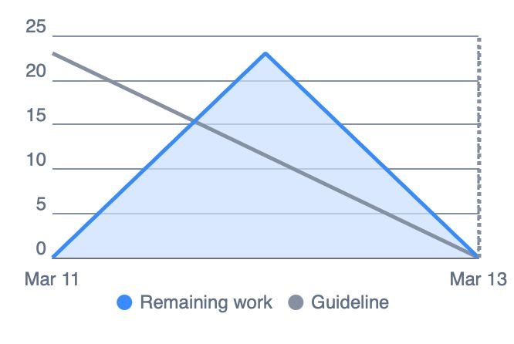
BurnDown Chart – Sprint 2
19

Slide 40
Burndown Chart – Sprint 3
19
Story Points
Days

Slide 41
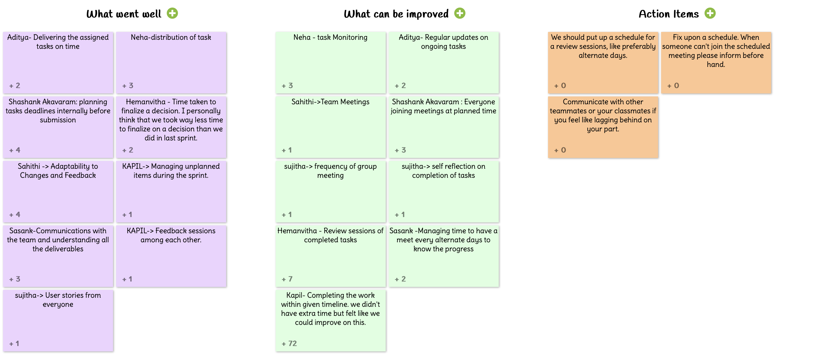
Retrospective – Sprint 2
20
16

Slide 42
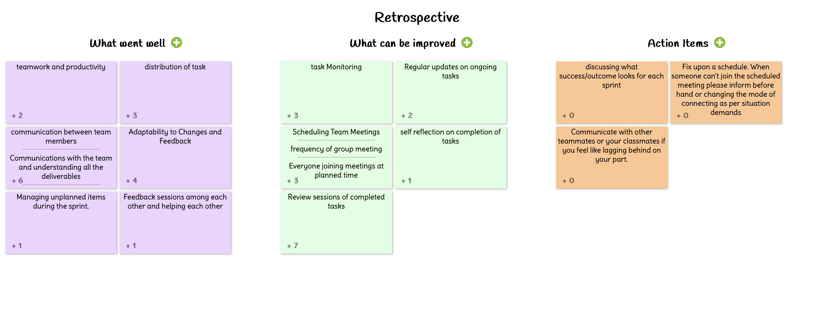
Retrospective – Sprint 3
20

Slide 43
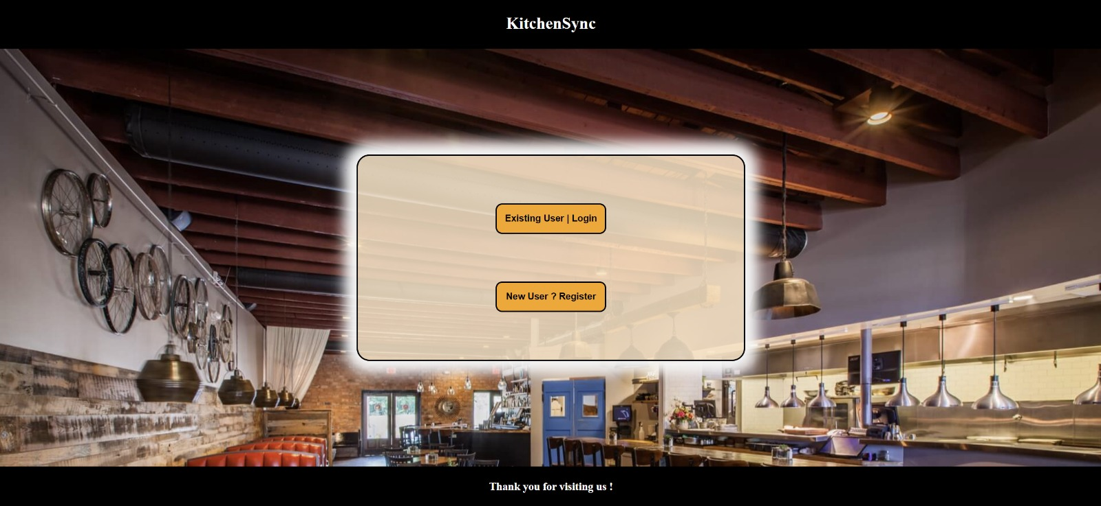
Webapp Screenshots
21

Slide 44
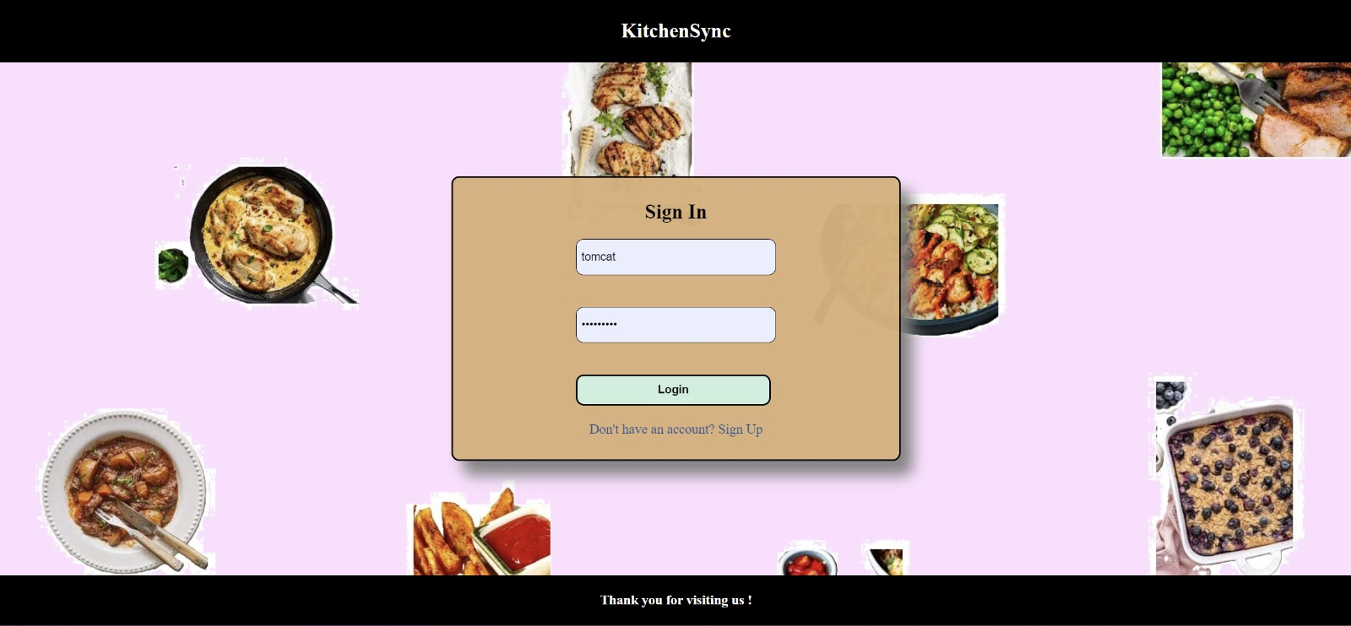
Webapp Screenshots

Slide 45
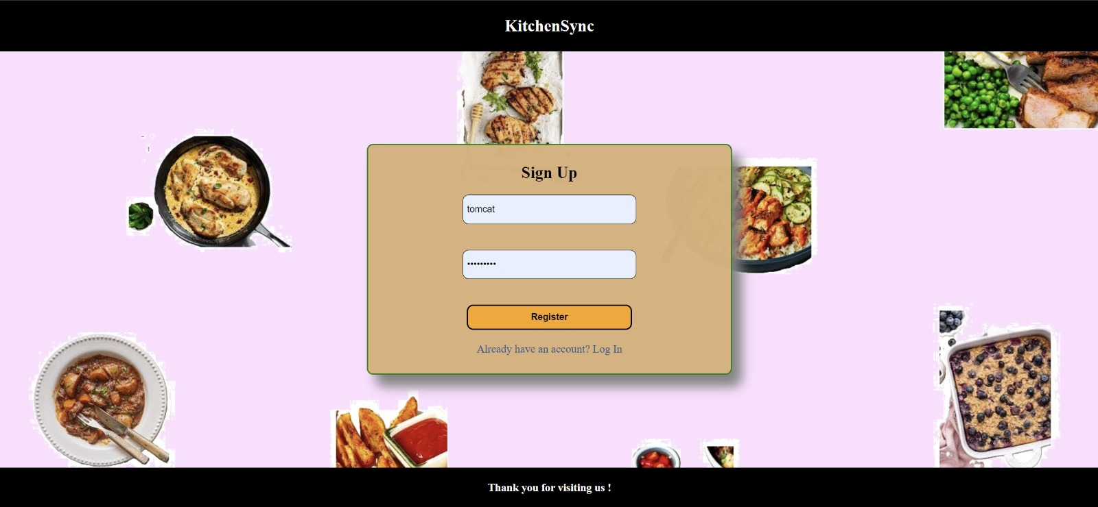
Webapp Screenshots

Slide 46
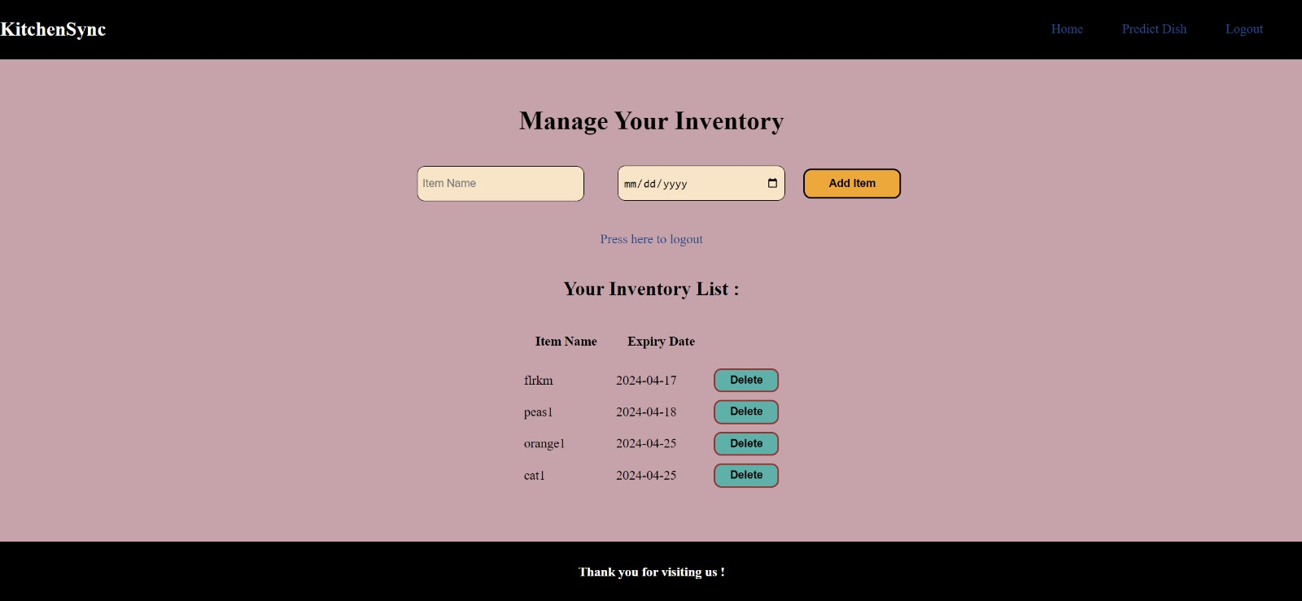
Webapp Screenshots

Slide 47
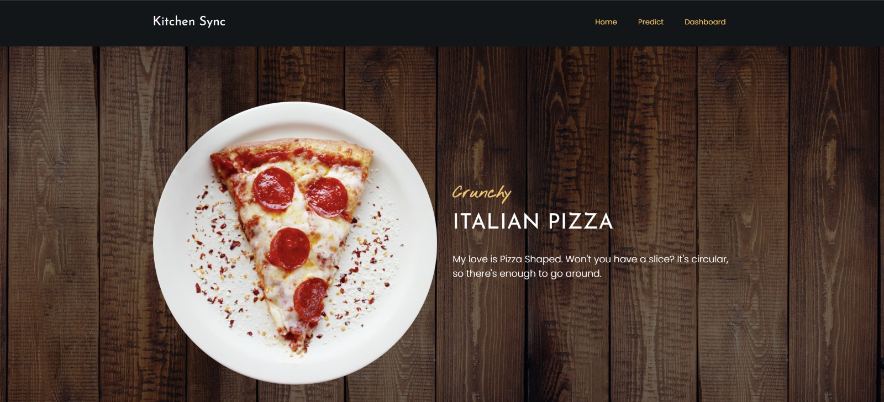
Webapp Screenshots

Slide 48
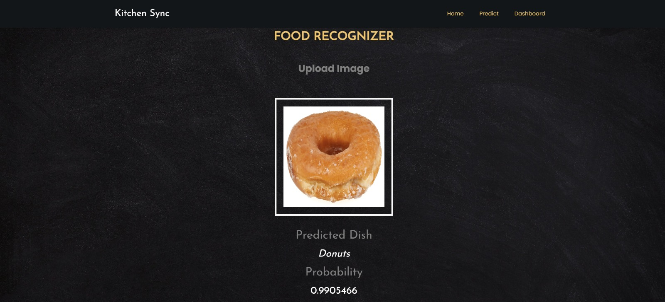
Webapp Screenshots

Slide 49
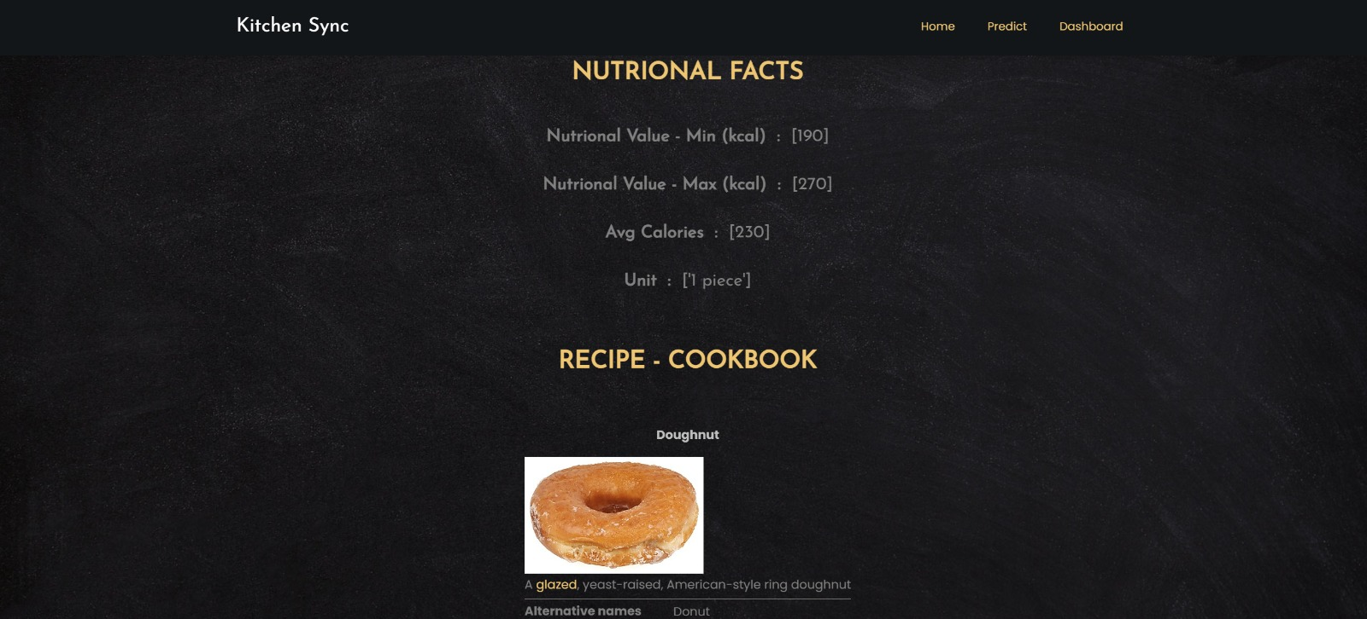
Webapp Screenshots

Slide 50


GITHUB:https://github.com/htmw/2024S-neon-nomads
22

Slide 51






Live App Demo
23

Slide 52
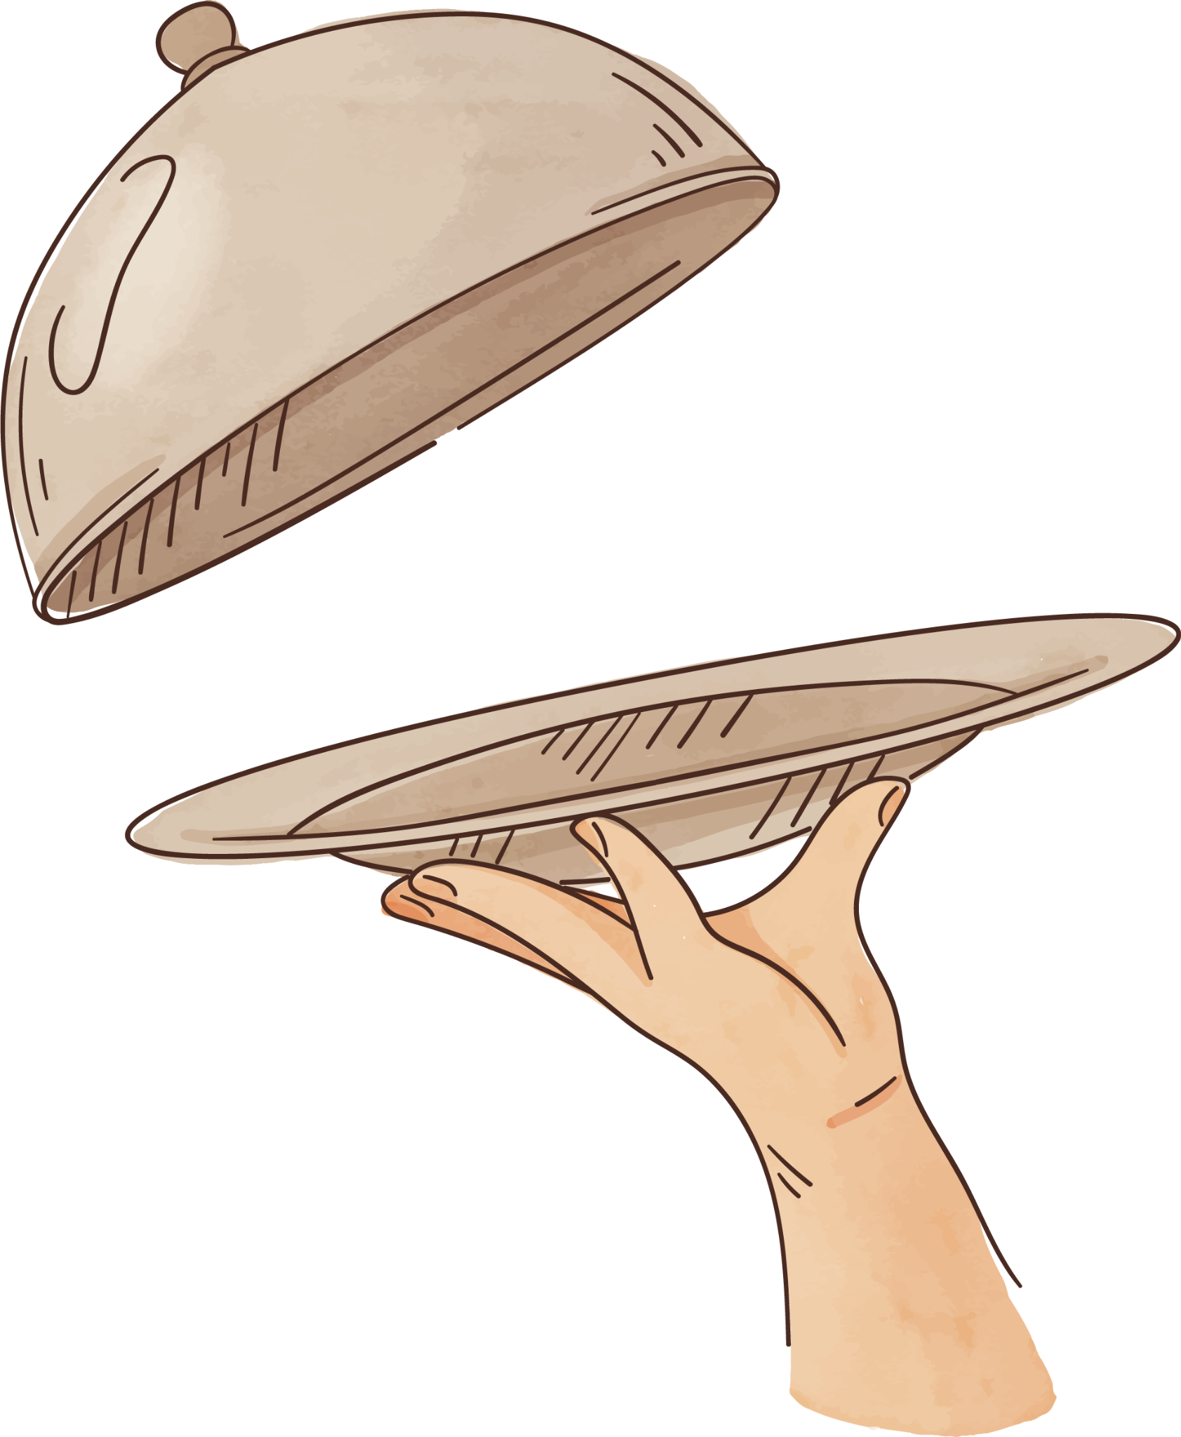

Bon Appétit!
Thanks

